Slide 1
EE653 Power distribution system modeling, optimization and simulation
ECpE Department
Dr. Zhaoyu Wang
1113 Coover Hall, Ames, IA
wzy@iastate.edu

Slide 2
Series Impedance of Overhead
and Underground Lines
Acknowledgement: The slides are developed based in part on Distribution System Modeling and Analysis, 4th edition, William H. Kersting, CRC Press, 2017

Slide 3
Series Impedance of Overhead and Underground Lines
The determination of the series impedance for overhead and underground lines is a critical step before the analysis of a distribution feeder can begin.
The series impedance of a single-phase, two-phase (V-phase), or three-phase distribution line consists of the resistance of the conductors and the self- and mutual inductive reactances resulting from the magnetic fields surrounding the conductors.
The resistance component for the conductors will typically come from a table of conductor data such as that found in Appendix A of Kersting Book.
ECpE Department

Slide 4
Overview – What’s phase impedance
Conductor Types (materials) & Construction Info (spacings)
Resistance (r)
Geometric Mean Radius (GMR)
Distances (D_{ij})
Modified Carston’s Equation
Primitive Impedance Matrix
$$\left[\hat{z_{primitive}}\right]$$
Partition Form
Kron reduction
Phase Impedance Matrix
$$\left[z_{abc}\right]$$
$$\left[\hat{z_{primitive}}\right]=\left[\begin{aligned}\left[\hat{z_{ij}}\right] \\ \left[\hat{z_{nj}}\right]\end{aligned}\begin{aligned}\left[\hat{z_{in}}\right] \\ \left[\hat{z_{nn}}\right]\end{aligned}\right]$$
ECpE Department

Slide 5
Overview – Why Carston’s equation
ECpE Department

Slide 6
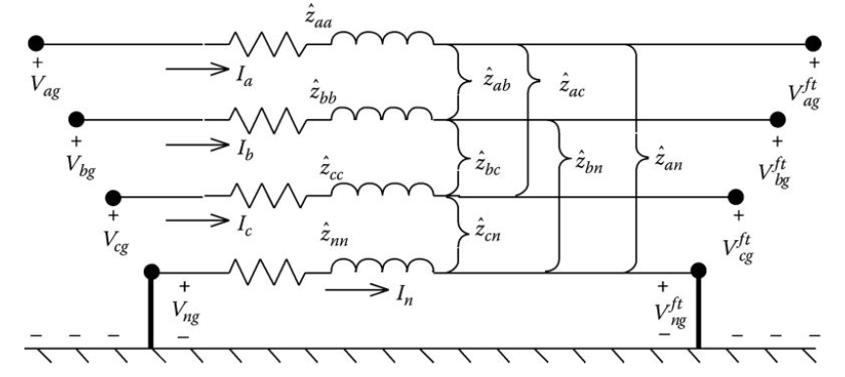
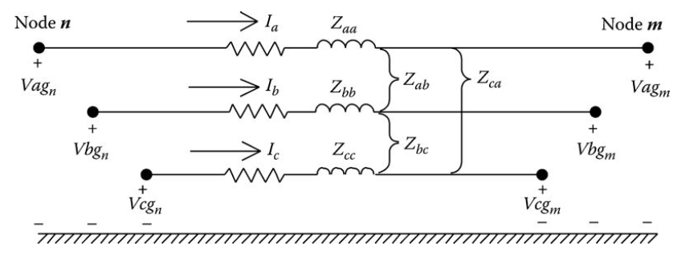
Overview – Primitive impedances v.s. Phase impedances
Primitive self- and mutual- impedances calculated using Carston’s equation
Neutral is modeled as an individual conductor. Hence, Z_{primitive} is 4x4 in this case.
Using Kron reduction, neutral conductor’s impact can be rounded into the phase conductor. Hence, Z_{abc} is 3x3.
ECpE Department

Slide 7
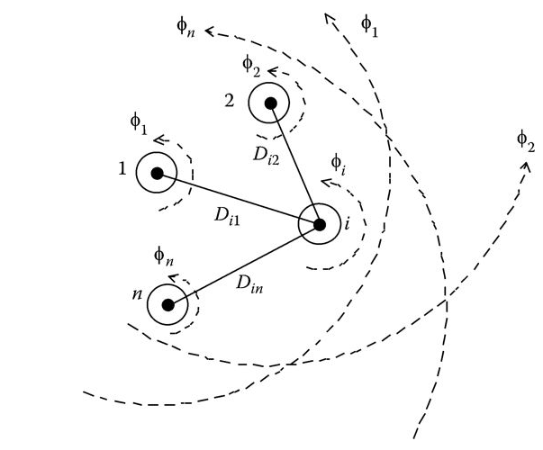
Series Impedance of Overhead Lines
The inductive reactance (self and mutual) component of the impedance is a function of the total magnetic fields surrounding a conductor. Fig.1 shows conductors 1 through n with the magnetic flux lines created by currents flowing in each of the conductors.
Fig.1 Magnetic field
ECpE Department

Slide 8
Series Impedance of Overhead Lines
The currents in all conductors are assumed to be flowing out of the page. It is further assumed that the sum of the currents will add to zero.
$I_{1}+I_{2}$+$…$+$I_{i}$+$…$+$I_{n}$=0
(1)
The total flux linking conductor i is given by
$λ_{i}$=N*$φ=2∗{10}^{−7}∗(I_{1}∗\ln{\frac{1}{D_{i1}}}+…I_{i}∗\ln{\frac{1}{{GMR}_{i}}}+…I_{n}∗\ln{\frac{1}{D_{in}}})$
(2)
where
N = Number of times the line of flux surrounds the conductor. For this case N = 1
D_{in} is the distance between conductor i and conductor n (ft)
GMR_{i} is the geometric mean radius of conductor i (ft)
Fig.1 Magnetic field
ECpE Department

Slide 9
Series Impedance of Overhead Lines
The inductance of conductor i consists of the “self-inductance” of conductor i and the “mutual inductance” between conductor i and all of the other n − 1 conductors. By definition,
Self-inductance:
$L_{ii}$=$\frac{λ_{ii}}{I_{i}}$= $2∗{10}^{−7}∗\ln{\frac{1}{{GMR}_{i}}}$ H/M
(3)
Mutual inductance:
$L_{in}$=$\frac{λ_{in}}{I_{n}}$= $2∗{10}^{−7}∗\ln{\frac{1}{D_{in}}}$ H/M
(4)
ECpE Department

Slide 10
Transposed Three-phase Lines
High-voltage transmission lines are usually assumed to be transposed (each phase occupies the same physical position on the structure for one-third of the length of the line). In addition to the assumption of transposition, it is assumed that the phases are equally loaded (balanced loading).
With these two assumptions, it is possible to combine the “self” and “mutual” terms into one “phase” inductance.
Phase inductance:
$L_{i}$= $2∗{10}^{−7}∗\ln{\frac{D_{eq}}{{GMR}_{i}}}$ H/M
(5)
where
$D_{eq}$=$\sqrt[3]{D_{ab}∗D_{bc}∗D_{ca}}$ ft
(6)
D_{ab}, D_{bc}, and D_{ca} are the distances between phases.
ECpE Department

Slide 11
Transposed Three-phase Lines
Assuming a frequency of 60 Hz, the phase inductive reactance is given by
Phase reactance:
${x_{i}=ω∗L}_{i}$=0$.12134∗\ln{\frac{D_{eq}}{{GMR}_{i}}}$ $Ω$/mile
(7)
The series impedance per phase of a transposed three-phase line consisting of one conductor per phase is given by
Series impedance:
$z_{i}$=$r_{i}$+j $∗$0$.12134∗\ln{\frac{D_{eq}}{{GMR}_{i}}}$ $Ω$/mile
(8)
ECpE Department

Slide 12
Untransposed Distribution Lines
Because distribution systems consist of single-phase, two-phase, and untransposed three-phase lines serving unbalanced loads, it is necessary to retain the identity of the self- and mutual impedance terms of the conductors.
The resistance of the conductors is taken directly from a table of conductor data. Equations (3) and (4) are used to compute the self- and mutual inductive reactances of the conductors.
The inductive reactance will be assumed to be at a frequency of 60 Hz, and the length of the conductor will be assumed to be 1 mile. With those assumptions, the self- and mutual impedances are given by
$L_{ii}$=$\frac{λ_{ii}}{I_{i}}$= $2∗{10}^{−7}∗\ln{\frac{1}{{GMR}_{i}}}$ H/M
(3)
$L_{in}$=$\frac{λ_{in}}{I_{n}}$= $2∗{10}^{−7}∗\ln{\frac{1}{D_{in}}}$ H/M
(4)
$$\overline{z_{ii}}{=r}_{i}\text{+}j\text{0}.12134∗\ln{\frac{1}{{GMR}_{i}}} Ω\text{/}\text{mile}$$
(9)
$$\overline{z_{ij}}=j\text{0}.12134∗\ln{\frac{1}{D_{ij}}} Ω\text{/}\text{mile}$$
(10)
However, this is not enough, as we also have to take into account the ground return path for the unbalanced currents.
ECpE Department

Slide 13
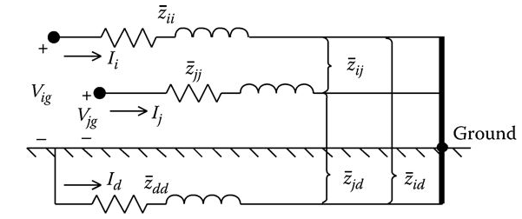
Untransposed Distribution Lines
In 1926, John Carson published a paper where he developed a set of equations for computing the self- and mutual impedances of lines taking into account the return path of current through ground [1].
Carson's approach was to represent a line with the conductors connected to a source at one end and grounded at the remote end.
Fig.2 illustrates a line consisting of two conductors (i and j) carrying currents (I_{i} and I_{j}) with the remote ends of the conductors tied to ground. A fictitious “dirt” conductor carrying current I_{d} is used to represent the return path for the currents.
Fig.2 Two conductors with dirt return path
[1] Carson, J.R., Wave propagation in overhead wires with ground return, Bell System Technical Journal, 5, 539, 1926.
ECpE Department

Slide 14
Untransposed Distribution Lines
In Fig.2, Kirchhoff's voltage law (KVL) is used to write the equation for the voltage between conductor i and ground:
$$V_{ig}=\overline{z_{ii}}∗I_{i}+\overline{z_{ij}}∗I_{j}+\overline{z_{id}}∗I_{d}−(\overline{z_{dd}}∗I_{d}+\overline{z_{di}}∗I_{i}+\overline{z_{dj}}∗I_{j})$$
Collect terms in Equation (11):
(11)
$$V_{ig}= \left(\overline{z_{ii}}−\overline{z_{di}}\right)∗I_{i}+(\overline{z_{ij}}−\overline{z_{dj}})∗I_{j}+ (\overline{z_{id}}−\overline{z_{dd}})∗I_{d}$$
(12)
Fig.2 Two conductors with dirt return path
ECpE Department

Slide 15
Untransposed Distribution Lines
$$V_{ig}= \left(\overline{z_{ii}}−\overline{z_{dn}}\right)∗I_{i}+(\overline{z_{ij}}−\overline{z_{dj}})∗I_{j}+ (\overline{z_{id}}−\overline{z_{dd}})∗I_{d}$$
(12)
From Kirchhoff's current law
$I_{i}+I_{j}+I_{d}$=0, $I_{d}$=${−I}_{i}$ $− I_{j}$
(13)
Substitute Equation (13) into Equation (12) and collect terms:
$V_{ig}= \left(\overline{z_{ii}}+\overline{z_{dd}}−\overline{z_{di}}−\overline{z_{id}}\right)∗I_{i}$ $+(\overline{z_{ij}}+\overline{z_{dd}}−\overline{z_{dj}}−\overline{z_{id}})∗I_{j}$
(14)
Equation (14) is of the general form
$$V_{ig}= \hat{z_{ii}}∗I_{i}+\hat{z_{ij}}∗I_{j}$$
(15)
where
(16)
$$\hat{z_{ii}}=\overline{z_{ii}}+\overline{z_{dd}}−\overline{z_{di}}−\overline{z_{id}}$$
$$\hat{z_{ij}}=\overline{z_{ij}}+\overline{z_{dd}}−\overline{z_{dj}}−\overline{z_{id}}$$
(17)
ECpE Department

Slide 16
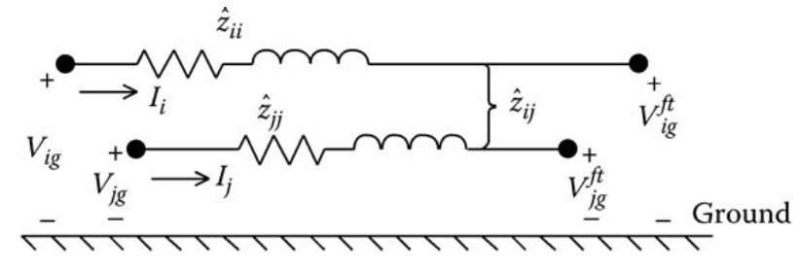
Untransposed Distribution Lines
$$\overline{z_{ii}}{=r}_{i}\text{+}j\text{0}.12134∗\ln{\frac{1}{{GMR}_{i}}} Ω\text{/}\text{mile}$$
(9)
(16)
$$\hat{z_{ii}}=\overline{z_{ii}}+\overline{z_{dd}}−\overline{z_{di}}−\overline{z_{id}}$$
$$\overline{z_{ij}}=j\text{0}.12134∗\ln{\frac{1}{D_{ij}}} Ω\text{/}\text{mile}$$
(10)
$$\hat{z_{ij}}=\overline{z_{ij}}+\overline{z_{dd}}−\overline{z_{dj}}−\overline{z_{id}}$$
(17)
In Equations (16) and (17), the “hat” impedances are given by Equations (9) and (10). Note that in these two equations the effect of the ground return path is being “folded” into what will now be referred to as the “primitive” self- and mutual impedances of the line. The “equivalent primitive circuit” is shown in Fig.3.
Fig.3 Equivalent primitive circuit
ECpE Department

Slide 17
Untransposed Distribution Lines
$$\overline{z_{ii}}{=r}_{i}\text{+}j\text{0}.12134∗\ln{\frac{1}{{GMR}_{i}}} Ω\text{/}\text{mile}$$
(9)
(16)
$$\hat{z_{ii}}=\overline{z_{ii}}+\overline{z_{dd}}−\overline{z_{di}}−\overline{z_{id}}$$
$$\overline{z_{ij}}=j\text{0}.12134∗\ln{\frac{1}{D_{ij}}} Ω\text{/}\text{mile}$$
(10)
$$\hat{z_{ij}}=\overline{z_{ij}}+\overline{z_{dd}}−\overline{z_{dj}}−\overline{z_{id}}$$
(17)
Substituting Equations (9) and (10) of the “hat” impedances into Equations (16) and (17), the primitive self-impedance is given by
$$\hat{z_{ii}}=r_{i}+jx_{ii}+r_{d}+jx_{dd}−jx_{dn}−jx_{nd}$$
$\hat{z_{ii}}=r_{i}+r_{d}+\text{j}\text{0}.12134∗(\ln{\frac{1}{{GMR}_{i}}}+\ln{\frac{1}{{GMR}_{d}}}$ $− \ln{\frac{1}{D_{id}}}$ $− \ln{\frac{1}{D_{di}}}$)
$\hat{z_{ii}}=r_{d}+r_{i}+\text{j}\text{0}.12134∗(\ln{\frac{1}{{GMR}_{i}}}+\ln{\frac{D_{id}∗D_{dj}}{{GMR}_{d}}}$)
(18)
In a similar manner, the primitive mutual impedance can be expanded:
$\hat{z_{ij}}=jx_{ij}+r_{d}$ $+ jx_{dd}$ $− jx_{dj}$ $− jx_{id}$
$=r_{d}+\text{j}\text{0}.12134∗(\ln{\frac{1}{D_{ij}}}+\ln{\frac{D_{dj}∗D_{id}}{{GMR}_{d}}}$)
(19)
ECpE Department

Slide 18
Untransposed Distribution Lines
$\hat{z_{ii}}=r_{d}+r_{i}+\text{j}\text{0}.12134∗(\ln{\frac{1}{{GMR}_{i}}}+\ln{\frac{D_{id}∗D_{dj}}{{GMR}_{d}}}$)
(18)
$\hat{z_{ij}}=r_{d}+\text{j}\text{0}.12134∗(\ln{\frac{1}{D_{ij}}}+\ln{\frac{D_{dj}∗D_{id}}{{GMR}_{d}}}$)
(19)
The obvious problem in using Equations (18) and (19) is the fact that we do not know the values of the resistance of dirt (r_{d}), the geometric mean radius of dirt (GMR_{d}), and the distances from the conductors to dirt (D_{nd}, D_{dn}, D_{md}, D_{dm}). This is where John Carson's work bails us out.
ECpE Department

Slide 19
Carson’s Equations
Since a distribution feeder is inherently unbalanced, the most accurate analysis should not make any assumptions regarding the spacing between conductors, conductor sizes, and transposition.
In Carson's 1926 paper, he developed a technique whereby the self- and mutual impedances for ncond overhead conductors can be determined. The equations can also be applied to underground cables.
In his paper, Carson assumes the earth is an infinite, uniform solid, with a flat uniform upper surface and a constant resistivity. Any “end effects” introduced at the neutral grounding points are not large at power frequencies and therefore are neglected.
ECpE Department

Slide 20
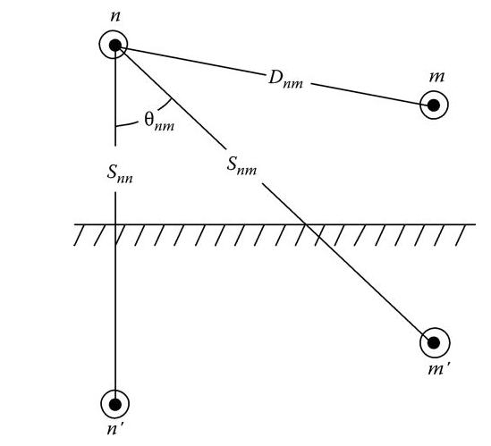
Carson’s Equations
Carson made use of conductor images; that is, every conductor at a given distance above ground has an image conductor the same distance below ground. This is illustrated in Fig.4.
Fig.4 Conductors and images
ECpE Department

Slide 21
Carson’s Equations
Referring to Fig.4, the original Carson's equations are given in Equations (20) and (21).
Self-impedance:
$\hat{z_{ii}}=r_{i}+4ωP_{ii}G+j(X_{i}+2ωG∗ln{\frac{S_{ii}}{{RD}_{i}}}+4ωQ_{ii}G$) $Ω\text{/}\text{mile}$
(20)
Mutual impedance:
$\hat{z_{ij}}=4ωP_{ij}G+j(2ωG∗ln{\frac{S_{ij}}{D_{ij}}}+4ωQ_{ij}G$) $Ω\text{/}\text{mile}$
(21)
$$X_{i}=2ωG∗ln{\frac{{RD}_{i}}{{GMR}_{i}}}Ω\text{/}\text{mile}$$
(22)
$$P_{ij}=\frac{π}{8}−\frac{1}{3\sqrt{2}}k_{ij}\cos\left(θ_{ij}\right)+\frac{k_{ij}^{2}}{16}\cos\left(2θ_{ij}\right)∗(0.6728+\ln{\frac{2}{k_{ij}}})$$
(23)
$$Q_{ij}=−0.0.386+\frac{1}{2}∗\ln{\frac{2}{k_{ij}}}+\frac{1}{3\sqrt{2}}k_{ij}cos\left(θ_{ij}\right)$$
(24)
$$k_{ij}=8.565∗{10}^{−4}∗S_{ij}∗\sqrt{\frac{f}{ρ}}$$
(25)
Fig.4 Conductors and images
ECpE Department

Slide 22
Carson’s Equations
Referring to Fig.4, the original Carson's equations are given in Equations (20) and (21).
$\hat{z_{ii}}$ is the self-primitive impedance of conductor i (Ω/mile)
$\hat{z_{ij}}$ is the mutual primitive impedance between conductors i and j (Ω/mile)
r_{i} is the resistance of conductor i (Ω/mile)
ω = 2πf is the system angular frequency (rad/s)
G = 0.1609347 × 10⁻³ Ω/mile
RD_{i} is the radius of conductor i (ft)
GMR_{i} is the geometric mean radius of conductor i (ft)
f is thwheree system frequency (Hz)
ρ is the resistivity of earth (Ω-m)
D_{ij} is the distance between conductors i and j (ft) (see Fig.4)
S_{ij} is the distance between conductor i and image j (ft) (see Fig.4)
θ_{ij} is the angle between a pair of lines drawn from conductor i to its own image and to the image of conductor j (see Fig.4)
Fig.4 Conductors and images
ECpE Department

Slide 23
Modified Carson’s Equations
Only two approximations are made in deriving the “modified Carson's Equations.” These approximations involve the terms associated with P_{ij} and Q_{ij}. The approximations use only the first term of the variable P_{ij} and the first two terms of Q_{ij}:
$$P_{ij}=\frac{π}{8}$$
(26)
$$Q_{ij}=−0.03860+\frac{1}{2} ln{\frac{2}{k_{ij}}}$$
(27)
Using the approximations and assumptions the “modified Carson's equations” are
$\hat{z_{ii}}=r_{i}+0.09530+j0.12134(\ln{\frac{1}{{GMR}_{i}}}+7.93402$) $Ω\text{/}\text{mile}$
(28)
$$\hat{z_{ij}}=0.09530+j0.12134(\ln{\frac{1}{D_{ij}}}+7.93402\text{)}Ω\text{/}\text{mile}$$
(29)
ECpE Department

Slide 24
Modified Carson’s Equations
$\hat{z_{ii}}=r_{d}+r_{i}+\text{j}\text{0}.12134∗(\ln{\frac{1}{{GMR}_{i}}}+\ln{\frac{D_{id}∗D_{dj}}{{GMR}_{d}}}$)
(18)
$\hat{z_{ij}}=r_{d}+\text{j}\text{0}.12134∗(\ln{\frac{1}{D_{ij}}}+\ln{\frac{D_{dj}∗D_{id}}{{GMR}_{d}}}$)
(19)
$\hat{z_{ii}}=r_{i}+0.09530+j0.12134(\ln{\frac{1}{{GMR}_{i}}}+7.93402$) $Ω\text{/}\text{mile}$
(28)
$$\hat{z_{ij}}=0.09530+j0.12134(\ln{\frac{1}{D_{ij}}}+7.93402\text{)}Ω\text{/}\text{mile}$$
(29)
It will be recalled that Equations (18) and (19) could not be used because the resistance of dirt, the GMR of dirt, and the various distances from conductors to dirt were not known. A comparison of Equations (18) and (19) to Equations (28) and (29) demonstrates that the modified Carson's equations have defined the missing parameters. A comparison of the two sets of equations shows that
$$r_{d}=0.09530 Ω\text{/}\text{mile}$$
(30)
$$\ln{\frac{D_{id}∗D_{di}}{{GMR}_{d}}}=\ln{\frac{D_{dj}∗D_{id}}{{GMR}_{d}}}=7.93402$$
(31)
ECpE Department

Slide 25
Modified Carson’s Equations
The “modified Carson's equations” will be used to compute the primitive self- and mutual impedances of overhead and underground lines.
There have been some questions about the approximations made in developing the modified Carson's equations. A paper was presented at the IEEE 2011 Power System Conference and Exposition [3]. In that paper, the full and modified equations were used and a comparison was made of the “errors.” It was found that the errors were less than 1%. In that paper, the values of the resistivity of 10 and 1000 Ω-m were used instead of the assumed 100 Ω-m. A comparison was made and again the errors were found to be less than 1%. Because of the results in the paper, the modified equations developed earlier will not change.
[3] Kersting, W.H. and Green, R.K., Application of Carson's equations to the steady-state analysis of distribution feeders, IEEE Power System Conference and Exposition, Phoenix, AZ, March 2011.
ECpE Department

Slide 26
Primitive Impedance Matrix for Overhead Lines
The “modified Carson's equations” will be used to compute the primitive self- and mutual impedances of overhead and underground lines.
$\hat{z_{ii}}=r_{i}+0.09530+j0.12134(\ln{\frac{1}{{GMR}_{i}}}+7.93402$) $Ω\text{/}\text{mile}$
(28)
$$\hat{z_{ij}}=0.09530+j0.12134(\ln{\frac{1}{D_{ij}}}+7.93402\text{)}Ω\text{/}\text{mile}$$
(29)
Equations (28) and (29) are used to compute the elements of a ncond × ncond “primitive impedance matrix.” An overhead four-wire grounded wye distribution line segment will result in a 4 × 4 matrix. For an underground grounded wye line segment consisting of three concentric neutral cables, the resulting matrix will be 6 × 6. The primitive impedance matrix for a three-phase line consisting of m neutrals will be of the form
$$\left[\hat{z_{primitive}}\right]=\left[\begin{aligned}\begin{matrix}\hat{z_{aa}} & \hat{z_{ab}} & \hat{z_{ac}} \\ \hat{z_{ba}} & \hat{z_{bb}} & \hat{z_{bc}} \\ \hat{z_{ca}} & \hat{z_{cb}} & \hat{z_{cc}} \end{matrix}\begin{matrix}\hat{z_{an1}} & \hat{z_{an2}} & \hat{z_{anm}} \\ \hat{z_{bn1}} & \hat{z_{bn2}} & \hat{z_{bnm}} \\ \hat{z_{cn1}} & \hat{z_{cn2}} & \hat{z_{cnm}}\end{matrix} \\ \begin{matrix}\hat{z_{n1a}} & \hat{z_{n1b}} & \hat{z_{n1c}} \\ \hat{z_{n2a}} & \hat{z_{n2b}} & \hat{z_{n2c}} \\ \hat{z_{nma}} & \hat{z_{nmb}} & \hat{z_{nmc}} \end{matrix}\begin{matrix}\hat{z_{n1n1}} & \hat{z_{n1n2}} & \hat{z_{n1nm}} \\ \hat{z_{n2n1}} & \hat{z_{n2n2}} & \hat{z_{n2nm}} \\ \hat{z_{nmn1}} & \hat{z_{nmn2}} & \hat{z_{nmnm}}\end{matrix}\end{aligned}\right]$$
(32)
ECpE Department

Slide 27
Primitive Impedance Matrix for Overhead Lines
$$\left[\hat{z_{primitive}}\right]=\left[\begin{aligned}\begin{matrix}\hat{z_{aa}} & \hat{z_{ab}} & \hat{z_{ac}} \\ \hat{z_{ba}} & \hat{z_{bb}} & \hat{z_{bc}} \\ \hat{z_{ca}} & \hat{z_{cb}} & \hat{z_{cc}} \end{matrix}\begin{matrix}\hat{z_{an1}} & \hat{z_{an2}} & \hat{z_{anm}} \\ \hat{z_{bn1}} & \hat{z_{bn2}} & \hat{z_{bnm}} \\ \hat{z_{cn1}} & \hat{z_{cn2}} & \hat{z_{cnm}}\end{matrix} \\ \begin{matrix}\hat{z_{n1a}} & \hat{z_{n1b}} & \hat{z_{n1c}} \\ \hat{z_{n2a}} & \hat{z_{n2b}} & \hat{z_{n2c}} \\ \hat{z_{nma}} & \hat{z_{nmb}} & \hat{z_{nmc}} \end{matrix}\begin{matrix}\hat{z_{n1n1}} & \hat{z_{n1n2}} & \hat{z_{n1nm}} \\ \hat{z_{n2n1}} & \hat{z_{n2n2}} & \hat{z_{n2nm}} \\ \hat{z_{nmn1}} & \hat{z_{nmn2}} & \hat{z_{nmnm}}\end{matrix}\end{aligned}\right]$$
(32)
In partitioned form, Equation (32) becomes
$$\left[\hat{z_{primitive}}\right]=\left[\begin{aligned}\left[\hat{z_{ij}}\right] \\ \left[\hat{z_{nj}}\right]\end{aligned}\begin{aligned}\left[\hat{z_{in}}\right] \\ \left[\hat{z_{nn}}\right]\end{aligned}\right]$$
(33)
ECpE Department

Slide 28
Phase Impedance Matrix for Overhead Lines
Fig.5 shows a four-wire grounded neutral line segment.
For most applications, the primitive impedance matrix needs to be reduced to a 3 × 3 “phase frame” matrix consisting of the self- and mutual equivalent impedances for the three phases.
One standard method of reduction is the “Kron” reduction. The assumption is made that the line has a multigrounded neutral as shown in Fig.5.
Fig.5 Four-wire grounded wye line segment
ECpE Department

Slide 29
Phase Impedance Matrix for Overhead Lines
The Kron reduction method applies KVL to the circuit:
$$\left[\begin{aligned}V_{ag} \\ V_{bg} \\ V_{cg} \\ V_{ng}\end{aligned}\right]=\left[\begin{aligned}V_{ag}^{′} \\ V_{bg}^{′} \\ V_{cg}^{′} \\ V_{ng}^{′}\end{aligned}\right]+\left[\begin{aligned}\begin{matrix}\hat{z_{aa}} & \hat{z_{ab}} \\ \hat{z_{ba}} & \hat{z_{bb}}\end{matrix}\begin{matrix} \hat{z_{ac}} & \hat{z_{an}} \\ \hat{z_{bc}} & \hat{z_{bn}}\end{matrix} \\ \begin{matrix}\hat{z_{ca}} & \hat{z_{cb}} \\ \hat{z_{na}} & \hat{z_{nb}}\end{matrix}\begin{matrix} \hat{z_{cc}} & \hat{z_{cn}} \\ \hat{z_{nc}} & \hat{z_{nn}}\end{matrix}\end{aligned}\right]\left[\begin{aligned}I_{g} \\ I_{b} \\ I_{c} \\ I_{n}\end{aligned}\right]$$
(34)
In partitioned form, Equation (34) becomes
$$\left[\begin{aligned}\left[V_{abc}\right] \\ \left[V_{ng}\right]\end{aligned}\right]=\left[\begin{aligned}\left[V_{abc}^{′}\right] \\ \left[V_{ng}^{′}\right]\end{aligned}\right]+\left[\begin{matrix}[\hat{z_{ij}}] & [\hat{z_{in}}] \\ [\hat{z_{ng}}] & [\hat{z_{nn}}]\end{matrix}\right]\left[\begin{aligned}\left[I_{abc}\right] \\ \left[I_{n}\right]\end{aligned}\right]$$
(35)
Because the neutral is grounded, the voltages V_{ng} and V′_{ng} are equal to zero. Substituting those values into Equation (35) and expanding result in
$\left[V_{abc}\right]=\left[V_{abc}^{′}\right]+\left[\hat{z_{ij}}\right]$*$\left[I_{abc}\right]+\left[\hat{z_{in}}\right]\text{∗}\left[I_{n}\right]$
(36)
$\left[0\right]=\left[0\right]+\left[\hat{z_{nj}}\right]$*$\left[I_{abc}\right]+\left[\hat{z_{nn}}\right]\text{∗}\left[I_{n}\right]$
(37)
ECpE Department

Slide 30
Phase Impedance Matrix for Overhead Lines
$\left[0\right]=\left[0\right]+\left[\hat{z_{nj}}\right]$*$\left[I_{abc}\right]+\left[\hat{z_{nn}}\right]\text{∗}\left[I_{n}\right]$
(37)
Solve Equation (37) for [I_{n}]:
$\left[I_{n}\right]=−{\left[\hat{z_{nj}}\right]}^{−1}\left[\hat{z_{nj}}\right]$*$\left[I_{abc}\right]$
(38)
Note in Equation (38) that once the line currents have been computed it is possible to determine the current flowing in the neutral conductor. Because this will be a useful concept later on, the “neutral transformation matrix” is defined as
(39)
$$\left[t_{n}\right]=−{\left[\hat{z_{nn}}\right]}^{−1}\left[\hat{z_{nj}}\right]$$
such that
$\left[I_{n}\right]=\left[t_{n}\right]$*$\left[I_{abc}\right]$
(40)
ECpE Department

Slide 31
Phase Impedance Matrix for Overhead Lines
$\left[V_{abc}\right]=\left[V_{abc}^{′}\right]+\left[\hat{z_{ij}}\right]$*$\left[I_{abc}\right]+\left[\hat{z_{in}}\right]\text{∗}\left[I_{n}\right]$
(36)
$\left[I_{n}\right]=−{\left[\hat{z_{nj}}\right]}^{−1}\left[\hat{z_{nj}}\right]$*$\left[I_{abc}\right]$
(38)
Substitute Equation (38) into Equation (36):
$$\left[V_{abc}\right]=\left[V_{abc}^{′}\right]+(\left[\hat{z_{ij}}\right]−\left[\hat{z_{in}}\right]{\left[\hat{z_{nn}}\right]}^{−1}\left[\hat{z_{nj}}\right]\text{)}\text{∗}\left[I_{abc}\right]$$
$$\left[V_{abc}\right]=\left[V_{abc}^{′}\right]+\left[z_{abc}\right]\text{∗}\left[I_{abc}\right]$$
(41)
where
$$\left[z_{abc}\right]=\left[\hat{z_{ij}}\right]−{\left[\hat{z_{in}}\right]∗\left[\hat{z_{nn}}\right]}^{−1}∗\left[\hat{z_{nj}}\right]$$
(42)
Equation (42) is the final form of the “Kron” reduction technique. The final phase impedance matrix becomes
$[z_{abc}]$=$\left[\begin{matrix}z_{aa} & z_{ab} & z_{ac} \\ z_{ba} & z_{bb} & z_{bc} \\ z_{ca} & z_{cb} & z_{cc}\end{matrix}\right] Ω/{mile}$
(43)
ECpE Department

Slide 32
Phase Impedance Matrix for Overhead Lines
$[z_{abc}]$=$\left[\begin{matrix}z_{aa} & z_{ab} & z_{ac} \\ z_{ba} & z_{bb} & z_{bc} \\ z_{ca} & z_{cb} & z_{cc}\end{matrix}\right] Ω/{mile}$
(43)
For a distribution line that is not transposed, the diagonal terms of Equation (43) will not be equal to each other, and the off-diagonal terms will not be equal to each other. However, the matrix will be symmetrical.
For two-phase (V-phase) and single-phase lines in grounded wye systems, the modified Carson's equations can be applied, which will lead to initial 3 × 3 and 2 × 2 primitive impedance matrices. Kron reduction will reduce the matrices to 2 × 2 and a single element. These matrices can be expanded to 3 × 3 “phase frame” matrices by the addition of rows and columns consisting of zero elements for the missing phases.
For example, for a V-phase line consisting of phases a and c, the phase impedance matrix would be
$[z_{abc}]$=$\left[\begin{matrix}z_{aa} & 0 & z_{ac} \\ 0 & 0 & 0 \\ z_{ca} & 0 & z_{cc}\end{matrix}\right] Ω/{mile}$
(44)
ECpE Department

Slide 33
Phase Impedance Matrix for Overhead Lines
The phase impedance matrix for a phase b single-phase line would be
$[z_{abc}]$=$\left[\begin{matrix}0 & 0 & 0 \\ 0 & z_{bb} & 0 \\ 0 & 0 & 0\end{matrix}\right] Ω/{mile}$
(45)
The phase impedance matrix for a three-wire delta line is determined by the application of Carson's equations without the Kron reduction step.
The phase impedance matrix can be used to accurately determine the voltage drops on the feeder line segments once the currents have been determined. Since no approximations (transposition, for example) have been made regarding the spacing between conductors, the effect of the mutual coupling between phases is accurately taken into account. The application of the modified Carson's equations and the phase frame matrix leads to the most accurate model of a line segment.
ECpE Department

Slide 34
Phase Impedance Matrix for Overhead Lines
Fig.6 shows the general three-phase model of a line segment. Keep in mind that for V-phase and single-phase lines some of the impedance values will be zero.
Fig.6 Three-phase line segment model
ECpE Department

Slide 35
Phase Impedance Matrix for Overhead Lines
The voltage equation in matrix form for the line segment is
${\left[\begin{aligned}V_{ag} \\ V_{bg} \\ V_{cg}\end{aligned}\right]}_{n}$=${\left[\begin{aligned}V_{ag} \\ V_{bg} \\ V_{cg}\end{aligned}\right]}_{m}+\left[\begin{matrix}Z_{aa} & Z_{ab} & Z_{ac} \\ Z_{ba} & Z_{bb} & Z_{bc} \\ Z_{ca} & Z_{cb} & Z_{cc}\end{matrix}\right]\left[\begin{aligned}I_{a} \\ I_{b} \\ I_{c}\end{aligned}\right]$
(46)
where Z_{ij} = z_{ij} · length.
Equation (46) can be written in “condensed” form as
$${\left[{VLG}_{abc}\right]}_{n}={\left[{VLG}_{abc}\right]}_{m}+\left[Z_{abc}\right]∗\left[\left[I_{abc}\right]\right]$$
(47)
ECpE Department

Slide 36
Sequence Impedances
Many times the analysis of a feeder will use only the positive and zero sequence impedances for the line segments. There are two methods for obtaining these impedances. The first method incorporates the application of the modified Carson's equations and the Kron reduction to obtain the phase impedance matrix.
The definition for line-to-ground phase voltages as a function of the line-to-ground sequence voltages is given by
$$\left[\begin{aligned}V_{ag} \\ V_{bg} \\ V_{cg}\end{aligned}\right]=\left[\begin{matrix}1 & 1 & 1 \\ 1 & a_{s}^{2} & a_{s} \\ 1 & a_{s} & a_{s}^{2}\end{matrix}\right]\left[\begin{aligned}{VLG}_{0} \\ {VLG}_{1} \\ {VLG}_{2}\end{aligned}\right]$$
(48)
Where $a_{s}=1.0∠120$
ECpE Department

Slide 37
Sequence Impedances
$$\left[\begin{aligned}V_{ag} \\ V_{bg} \\ V_{cg}\end{aligned}\right]=\left[\begin{matrix}1 & 1 & 1 \\ 1 & a_{s}^{2} & a_{s} \\ 1 & a_{s} & a_{s}^{2}\end{matrix}\right]\left[\begin{aligned}{VLG}_{0} \\ {VLG}_{1} \\ {VLG}_{2}\end{aligned}\right]$$
(48)
In condensed form, Equation (48) becomes
$$\left[{VLG}_{abc}\right]=\left[A_{S}\right]∗\left[{VLG}_{012}\right]$$
(49)
where
$[A_{s}]$=$\left[\begin{matrix}1 & 1 & 1 \\ 1 & a_{s}^{2} & a_{s} \\ 1 & a_{s} & a_{s}^{2}\end{matrix}\right]$
(50)
The phase line currents are defined in the same manner:
$$\left[I_{abc}\right]=\left[A_{S}\right]∗\left[I_{012}\right]$$
(51)
ECpE Department

Slide 38
Sequence Impedances
$$\left[{VLG}_{abc}\right]=\left[A_{S}\right]∗\left[{VLG}_{012}\right]$$
(49)
Equation (49) can be used to solve for the sequence line-to-ground voltages as a function of the phase line-to-ground voltages:
$$\left[{VLG}_{012}\right]={\left[A_{S}\right]}^{−1}∗\left[{VLG}_{abc}\right]$$
(52)
where
${[A_{s}]}^{−1}$=$\frac{1}{3}∗\left[\begin{matrix}1 & 1 & 1 \\ 1 & a_{s} & a_{s}^{2} \\ 1 & a_{s}^{2} & a_{s}\end{matrix}\right]$
(53)
ECpE Department

Slide 39
Sequence Impedances
$${\left[{VLG}_{abc}\right]}_{n}={\left[{VLG}_{abc}\right]}_{m}+\left[Z_{abc}\right]∗\left[I_{abc}\right]$$
(47)
$$\left[{VLG}_{abc}\right]=\left[A_{S}\right]∗\left[{VLG}_{012}\right]$$
(49)
Equation (47) can be transformed to the sequence domain by multiplying both sides by [A_{s}]⁻¹ and also substituting in the definition of the phase currents as given by Equation (49).
$${\left[{VLG}_{012}\right]}_{n}={\left[A_{S}\right]}^{−1}∗{\left[{VLG}_{abc}\right]}_{n}$$
$$={\left[A_{S}\right]}^{−1}∗{\left[{VLG}_{abn}\right]}_{m}+{\left[A_{S}\right]}^{−1}∗\left[Z_{abc}\right]∗\left[A_{S}\right]∗\left[I_{012}\right]$$
$$={\left[{VLG}_{012}\right]}_{m}+\left[Z_{012}\right]∗\left[I_{012}\right]$$
(54)
where
${\left[Z_{012}\right]=[A_{s}]}^{−1}[Z_{abc}]$ $[A_{s}]$=$\left[\begin{matrix}Z_{00} & Z_{01} & Z_{02} \\ Z_{10} & Z_{11} & Z_{12} \\ Z_{20} & Z_{21} & Z_{22}\end{matrix}\right]$
(55)
ECpE Department

Slide 40
Sequence Impedances
$${\left[{VLG}_{012}\right]}_{n}={\left[A_{S}\right]}^{−1}∗{\left[{VLG}_{abc}\right]}_{n}$$
$$={\left[A_{S}\right]}^{−1}∗{\left[{VLG}_{abn}\right]}_{n}+{\left[A_{S}\right]}^{−1}∗\left[Z_{abc}\right]∗\left[A_{S}\right]∗\left[I_{012}\right]={\left[{VLG}_{012}\right]}_{m}+\left[Z_{012}\right]∗\left[I_{012}\right]$$
(54)
Equation (54) in expanded form is given by
${\left[\begin{aligned}{VLG}_{0} \\ {VLG}_{1} \\ {VLG}_{2}\end{aligned}\right]}_{n}$=${\left[\begin{aligned}{VLG}_{0} \\ {VLG}_{1} \\ {VLG}_{2}\end{aligned}\right]}_{m}+\left[\begin{matrix}Z_{00} & Z_{01} & Z_{02} \\ Z_{10} & Z_{11} & Z_{12} \\ Z_{20} & Z_{21} & Z_{22}\end{matrix}\right]{\left[\begin{aligned}I_{0} \\ I_{1} \\ I_{2}\end{aligned}\right]}_{n}$
(56)
ECpE Department

Slide 41
Sequence Impedances
${\left[Z_{012}\right]=[A_{s}]}^{−1}[Z_{abc}]$ $[A_{s}]$=$\left[\begin{matrix}Z_{00} & Z_{01} & Z_{02} \\ Z_{10} & Z_{11} & Z_{12} \\ Z_{20} & Z_{21} & Z_{22}\end{matrix}\right]$
(55)
Equation (55) is the defining equation for converting phase impedances to sequence impedances.
In Equation (55), the diagonal terms of the matrix are the “sequence impedances” of the line such that
Z₀₀ is the zero sequence impedance
Z₁₁ is the positive sequence impedance
Z₂₂ is the negative sequence impedance
ECpE Department

Slide 42
Sequence Impedances
${\left[Z_{012}\right]=[A_{s}]}^{−1}[Z_{abc}]$ $[A_{s}]$=$\left[\begin{matrix}Z_{00} & Z_{01} & Z_{02} \\ Z_{10} & Z_{11} & Z_{12} \\ Z_{20} & Z_{21} & Z_{22}\end{matrix}\right]$
(55)
The off-diagonal terms of Equation (55) represent the mutual coupling between sequences. In the idealized state, these off-diagonal terms would be zero. In order for this to happen, it must be assumed that the line has been transposed. For high-voltage transmission lines, this will generally be the case.
When the lines are transposed, the mutual coupling between phases (off-diagonal terms) is equal, and, consequently, the off-diagonal terms of the sequence impedance matrix become zero.
Since distribution lines are rarely, if ever, transposed, the mutual coupling between phases is not equal, and, as a result, the off-diagonal terms of the sequence impedance matrix will not be zero. This is the primary reason that distribution system analysis uses the phase domain rather than symmetrical components.
ECpE Department

Slide 43
Sequence Impedances
$[z_{abc}]$=$\left[\begin{matrix}z_{aa} & z_{ab} & z_{ac} \\ z_{ba} & z_{bb} & z_{bc} \\ z_{ca} & z_{cb} & z_{cc}\end{matrix}\right] Ω/{mile}$
(43)
If a line is assumed to be transposed, the phase impedance matrix is modified so the three diagonal terms are equal and all of the off-diagonal terms are equal.
The usual procedure is to set the three diagonal terms of the phase impedance matrix equal to the average of the diagonal terms of Equation (43) and the off-diagonal terms equal to the average of the off-diagonal terms of Equation (43).
When this is done the self- and mutual impedances are defined as
$$z_{s}=\frac{1}{3}∗\left(z_{aa}+z_{bb}+z_{cc}\right) Ω/mile$$
(57)
$$z_{m}=\frac{1}{3}∗\left(z_{ab}+z_{bc}+z_{ca}\right) Ω/mile$$
(58)
The phase impedance matrix is now defined as
$[z_{abc}]$=$\left[\begin{matrix}z_{s} & z_{m} & z_{m} \\ z_{m} & z_{s} & z_{m} \\ z_{m} & z_{m} & z_{s}\end{matrix}\right] Ω/{mile}$
(59)
ECpE Department

Slide 44
Sequence Impedances
${\left[Z_{012}\right]=[A_{s}]}^{−1}[Z_{abc}]$ $[A_{s}]$=$\left[\begin{matrix}Z_{00} & Z_{01} & Z_{02} \\ Z_{10} & Z_{11} & Z_{12} \\ Z_{20} & Z_{21} & Z_{22}\end{matrix}\right]$
(55)
When Equation (55) is used with this phase impedance matrix, the resulting sequence matrix is diagonal (off-diagonal terms are zero). The sequence impedances can be determined directly as
$$z_{00}=z_{s}+2∗z_{m} Ω/mile$$
(60)
$$z_{11}=z_{22}=z_{s}−z_{m} Ω/mile$$
(61)
A second method that is commonly used to determine the sequence impedances directly is to employ the concept of geometric mean distances (GMDs). The GMD between phases is defined as
$$D_{ij}={GMD}_{ij}=\sqrt[3]{D_{ab}∗D_{bc}∗D_{ca}} ft$$
(62)
The GMD between phases and neutral is defined as
(63)
$$D_{in}={GMD}_{in}=\sqrt[3]{D_{an}∗D_{bn}∗D_{cn}} ft$$
ECpE Department

Slide 45
Sequence Impedances
$\hat{z_{ii}}=r_{i}+0.09530+j0.12134(\ln{\frac{1}{{GMR}_{i}}}+7.93402$) $Ω\text{/}\text{mile}$
(30)
$$\hat{z_{ij}}=0.09530+j0.12134(\ln{\frac{1}{D_{ij}}}+7.93402\text{)} Ω\text{/}\text{mile}$$
(31)
The GMDs as defined earlier are used in Equations (30) and (31) to determine the various self- and mutual impedances of the line resulting in
$\hat{z_{ii}}=r_{i}+0.09530+j0.12134(\ln{\frac{1}{{GMR}_{i}}}+7.93402$) $Ω\text{/}\text{mile}$
(64)
$\hat{z_{nn}}=r_{n}+0.09530+j0.12134(\ln{\frac{1}{{GMR}_{n}}}+7.93402$) $Ω\text{/}\text{mile}$
(65)
$$\hat{z_{ij}}=0.09530+j0.12134(\ln{\frac{1}{D_{ij}}}+7.93402\text{)}Ω\text{/}\text{mile}$$
(66)
$$\hat{z_{in}}=0.09530+j0.12134(\ln{\frac{1}{D_{in}}}+7.93402\text{)}Ω\text{/}\text{mile}$$
(67)
Equations (64) through (67) will define a matrix of order ncond × ncond, where ncond is the number of conductors (phases plus neutrals) in the line segment.
ECpE Department

Slide 46
Sequence Impedances
(42)
$$\left[z_{abc}\right]=\left[\hat{z_{ij}}\right]−{\left[\hat{z_{in}}\right]∗\left[\hat{z_{nn}}\right]}^{−1}∗\left[\hat{z_{nj}}\right]$$
${\left[Z_{012}\right]=[A_{s}]}^{−1}[Z_{abc}]$ $[A_{s}]$=$\left[\begin{matrix}Z_{00} & Z_{01} & Z_{02} \\ Z_{10} & Z_{11} & Z_{12} \\ Z_{20} & Z_{21} & Z_{22}\end{matrix}\right]$
(55)
Application of the Kron reduction (Equation (42)) and the sequence impedance transformation (Equation (55)) lead to the following expressions for the zero, positive, and negative sequence impedances:
$$z_{00}=\hat{z_{ii}}+2∗\hat{z_{ij}}−3∗\left(\frac{{\hat{z_{in}}}^{2}}{\hat{z_{nn}}}\right)Ω/mile$$
(68)
$$z_{11}=z_{22}=r_{i}+j0.12134(\ln{\frac{D_{ij}}{{GMR}_{i}}}\text{) }Ω\text{/}\text{mile}$$
(69)
Equations (68) and (69) are recognized as the standard equations for the calculation of the line impedances when a balanced three-phase system and transposition are assumed.
ECpE Department

Slide 47
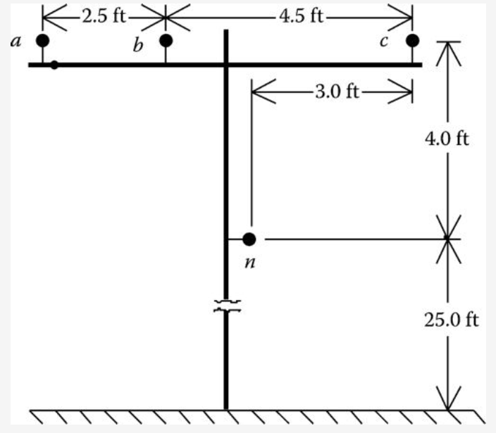
Example 1
An overhead three-phase distribution line is constructed as shown in Fig.7. Determine the phase impedance matrix and the positive and zero sequence of the line. The phase conductors are 336,400 26/7 ACSR (Linnet), and the neutral conductor is 4/0 6/1 ACSR.
Fig.7 Three-phase distribution line spacing
ECpE Department

Slide 48
Example 1
Solution
From the table of standard conductor data (Appendix A of Kersting Book), it is found that
336,400 26/7 ACSR: GMR=0.0244 ft, Resistance=0.306
4/0 6/1 ACSR: GMR=0.00814 ft, Resistance=0.5920
An effective way of computing the distance between all conductors is to specify each position on the pole in Cartesian coordinates using complex number notation. The ordinate will be selected as a point on the ground directly below the left most position. For the line in Fig.7, the positions are
$$d_{1}=0+j29, d_{2}=2.5+j29, d_{3}=7.0+j29, d_{4}=4.0+j25$$
The distances between the positions can be computed as
$D_{12}=\left|d_{1}−d_{2}\right|$, $D_{23}=\left|d_{2}−d_{3}\right|$, $D_{31}=\left|d_{3}−d_{1}\right|$
$D_{14}=\left|d_{1}−d_{4}\right|$, $D_{24}=\left|d_{2}−d_{4}\right|$, $D_{34}=\left|d_{3}−d_{4}\right|$
ECpE Department

Slide 49
Example 1
For this example, phase a is in position 1, phase b in position 2, phase c in position 3, and the neutral in position 4:
$D_{ab}=2.5 ft$, $D_{bc}=4.5 ft$, $D_{ca}=7.0 ft$
$D_{an}=5.6569 ft$, $D_{bn}=4.272 ft$, $D_{cn}=5.0 ft$
The diagonal terms of the distance matrix are the GMRs of the phase and neutral conductors:
$D_{aa}=D_{bb}=D_{cc}=0.0244$, $D_{nn}=0.00814$
Applying the modified Carson's equation for self-impedance (Equation (28)), the self-impedance for phase a is
$\hat{z_{aa}}=0.0953+0.306+j0.12134(\ln{\frac{1}{0.0244}}+7.93402$)=0.4013+j1.4133 $Ω\text{/}\text{mile}$
Applying Equation (29) for the mutual impedance between phases a and b
$$\hat{z_{ab}}=0.09530+j0.12134(\ln{\frac{1}{2.5}}+7.93402\text{)}=0.0953+j0.8515 Ω\text{/}\text{mile}$$
ECpE Department

Slide 50
Example 1
Applying the equations for the other self- and mutual impedance terms results in the primitive impedance matrix:
$\left[\hat{z}\right]=\left[\begin{matrix}\begin{aligned}0.4013+j1.4133 \\ 0.0953+j0.8515 \\ 0.0953+j0.7266 \\ 0.0953+j0.7524\end{aligned} & \begin{aligned}0.0953+j0.8515 \\ 0.4013+j1.4133 \\ 0.0953+j0.7802 \\ 0.0953+j0.7865\end{aligned} \begin{aligned}0.0953+j0.7266 \\ 0.0953+j0.7802 \\ 0.4013+j1.4133 \\ 0.0953+j0.7674\end{aligned} & \begin{aligned}0.0953+j0.7524 \\ 0.0953+j0.7865 \\ 0.0953+j0.7674 \\ 0.6873+j1.5465\end{aligned}\end{matrix}\right]$ $Ω\text{/}\text{mile}$
The primitive impedance matrix in partitioned form is
$\left[\hat{z_{ij}}\right]= \left[\begin{matrix}0.4013+j1.4133 & 0.0953+j0.8515 & 0.0953+j0.7266 \\ 0.0953+j0.8515 & 0.4013+j1.4133 & 0.0943+j0.7865 \\ 0.0953+j0.7266 & 0.0953+j0.7802 & 0.4013+j1.4133\end{matrix}\right]$ $Ω\text{/}\text{mile}$
$\left[\hat{z_{in}}\right]= \left[\begin{aligned}0.0953+j0.7524 \\ 0.0953+j0.7865 \\ 0.0953+j0.7674\end{aligned}\right]$ $Ω\text{/}\text{mile}$
$\left[\hat{z_{nn}}\right]= \left[0.6873+j1.5465\right]$ $Ω\text{/}\text{mile}$
ECpE Department

Slide 51
Example 1
$$\left[z_{abc}\right]=\left[\hat{z_{ij}}\right]−{\left[\hat{z_{in}}\right]∗\left[\hat{z_{nn}}\right]}^{−1}∗\left[\hat{z_{nj}}\right]$$
The “Kron” reduction of Equation (42) results in the “phase impedance matrix”:
$\left[z_{abc}\right]=\left[\hat{z_{ij}}\right]−{\left[\hat{z_{in}}\right]∗\left[\hat{z_{nn}}\right]}^{−1}∗\left[\hat{z_{nj}}\right]$
$= \left[\begin{matrix}0.4576+j1.0780 & 0.1560+j0.5017 & 0.1535+j0.3849 \\ 0.1560+j0.5017 & 0.4666+j1.0482 & 0.1580+j0.4236 \\ 0.1535+j0.3849 & 0.1580+j0.4236 & 0.4615+j1.0651\end{matrix}\right]$ $Ω\text{/}\text{mile}$
$$\left[t_{n}\right]=−{\left[\hat{z_{nn}}\right]}^{−1}\left[\hat{z_{nj}}\right]$$
The neutral transformation matrix given by Equation (39) is
$\left[t_{n}\right]=−{\left[\hat{z_{nn}}\right]}^{−1}\left[\hat{z_{nj}}\right]$=[-0.4292-j0.1291 -0.4476-j0.1373 -0.4373-j1327]
The phase impedance matrix can be transformed into the “sequence impedance matrix” with the application of Equation (53):
$$\left[z_{012}\right]={\left[A_{s}\right]}^{−1}\left[z_{abc}\right]\left[A_{s}\right]$$
$= \left[\begin{matrix}0.7735+j1.9373 & 0.0256+j0.0115 & −0.0321+j0.0159 \\ −0.0321+j0.0159 & 0.3061+j0.6270 & −0.0723−j0.0060 \\ 0.0256+j0.0115 & 0.0723−j0.0059 & 0.3061+j0.6270\end{matrix}\right]$ $Ω\text{/}\text{mile}$
ECpE Department

Slide 52
Example 1
In the sequence impedance matrix, the 1,1 term is the zero sequence impedance, the 2,2 term is the positive sequence impedance, and the 3,3 term is the negative sequence impedance. The 2,2 and 3,3 terms are equal, which demonstrates that for line segments, the positive and negative sequence impedances are equal.
Note that the off-diagonal terms are not zero. This implies that there is mutual coupling between sequences. This is a result of the nonsymmetrical spacing between phases. With the off-diagonal terms being nonzero, the three sequence networks representing the line will not be independent. However, it is noted that the off-diagonal terms are small relative to the diagonal terms.
In high-voltage transmission lines, it is usually assumed that the lines are transposed and that the phase currents represent a balanced three-phase set. The transposition can be simulated in Example 1 by replacing the diagonal terms of the phase impedance matrix with the average value of the diagonal terms (0.4619 + j1.0638) and replacing each off-diagonal term with the average of the off-diagonal terms (0.1558 + j0.4368).
ECpE Department

Slide 53
Example 1
This modified phase impedance matrix becomes
$\left[{z1}_{abc}\right]= \left[\begin{matrix}0.4619+j1.0638 & 0.1558+j0.4368 & 0.1558+j0.4368 \\ 0.1558+j0.4368 & 0.4619+j1.0638 & 0.1558+j0.4368 \\ 0.1558+j0.4368 & 0.1580+j0.4268 & 0.4619+j1.0638\end{matrix}\right]$ $Ω\text{/}\text{mile}$
Using this modified phase impedance matrix in the symmetrical component transformation equation results in the modified sequence impedance matrix:
$\left[{z1}_{012}\right]= \left[\begin{matrix}0.7735+j1.9373 & 0 & 0 \\ 0 & 0.3061+j0.6270 & 0 \\ 0 & 0 & 0.3061+j0.6270\end{matrix}\right]$ $Ω\text{/}\text{mile}$
Note now that the off-diagonal terms are all equal to zero, meaning that there is no mutual coupling between sequence networks. It should also be noted that the modified zero, positive, and negative sequence impedances are exactly equal to the exact sequence impedances that were first computed.
The results of this example should not be interpreted to mean that a three-phase distribution line can be assumed to have been transposed. The original phase impedance matrix must be used if the correct effect of the mutual coupling between phases is to be modeled.
ECpE Department

Slide 54
Parallel Overhead Distribution Lines
It is fairly common in a distribution system to find instances where two distribution lines are “physically” parallel. The parallel combination may have both distribution lines constructed on the same pole or the two lines may run in parallel on separate poles but on the same right-of-way.
For example, two different feeders leaving a substation may share a common pole or right-of-way before they branch out to their own service areas. It is also possible that two feeders may converge and run in parallel until again they branch out into their own service areas. The lines could also be underground circuits sharing a common trench.
In all of the cases, the question becomes, How should the parallel lines be modeled and analyzed?
ECpE Department

Slide 55
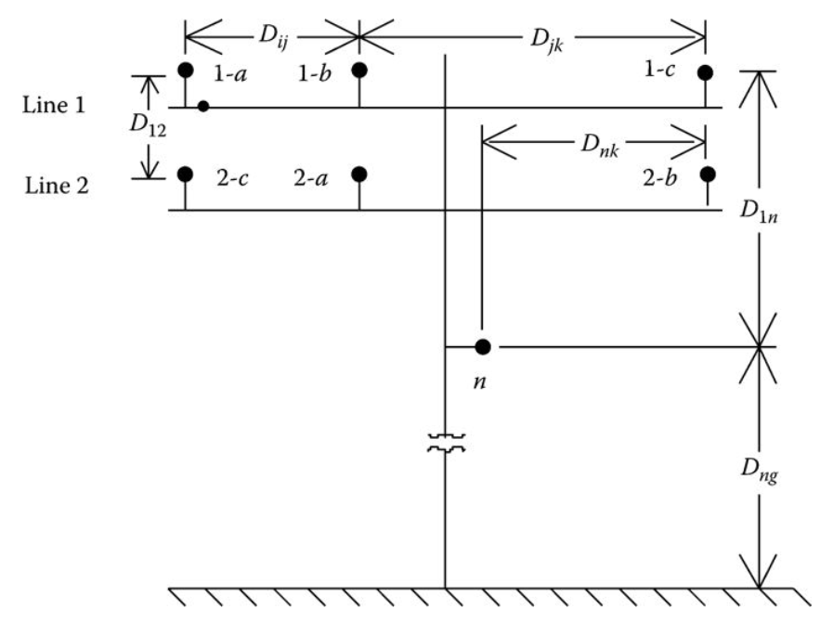
Parallel Overhead Distribution Lines
Two parallel overhead lines on one pole are shown in Fig.8. Note in Fig.8 the phasing of the two lines.
Fig.8 Parallel overhead line
ECpE Department

Slide 56
Parallel Overhead Distribution Lines
The phase impedance matrix for the parallel distribution lines is computed by the application of Carson's equations and the Kron reduction method. The first step is to number the phase positions as follows:
Position | 1 | 2 | 3 | 4 | 5 | 6 | 7
Line phase | 1-a | 1-b | 1-c | 2-a | 2-b | 2-c | Neutral
With the phases numbered, the 7 × 7 primitive impedance matrix for 1 mile can be computed using the modified Carson's equations.
It should be pointed out that if the two parallel lines are on different poles, most likely each pole will have a grounded neutral conductor. In this case, there will be eight positions, and position 8 will correspond to the neutral on line 2. An 8 × 8 primitive impedance matrix will be developed for this case.
ECpE Department

Slide 57
Parallel Overhead Distribution Lines
The Kron reduction will reduce the matrix to a 6 × 6 phase impedance matrix. With reference to Fig.8, the voltage drops in the two lines are given by
(70)
Partition Equation (70) between the third and fourth rows and columns so that series voltage drops for 1 mile of line are given by
(71)
ECpE Department

Slide 58
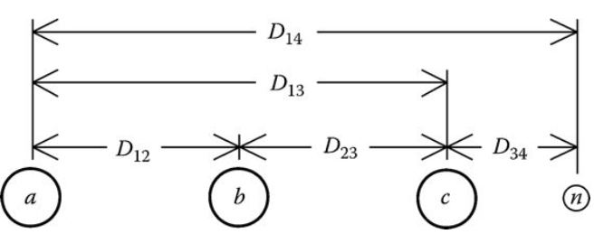
Series Impedance of Underground Cables
Fig.9 shows the general configuration of three underground cables (concentric neutral or tape shielded) with an additional neutral conductor.
The modified Carson's equations can be applied to underground cables in much the same manner as for overhead lines. The circuit of Fig.9 will result in a 7 × 7 primitive impedance matrix. For underground circuits that do not have the additional neutral conductor, the primitive impedance matrix will be 6 × 6.
Fig.9 Three-phase underground with additional neutral
Two popular types of underground cables are the “concentric neutral cable” and the “tape shield cable.” To apply the modified Carson's equations, the resistance and GMR of the phase conductor and the equivalent neutral must be known.
ECpE Department

Slide 59
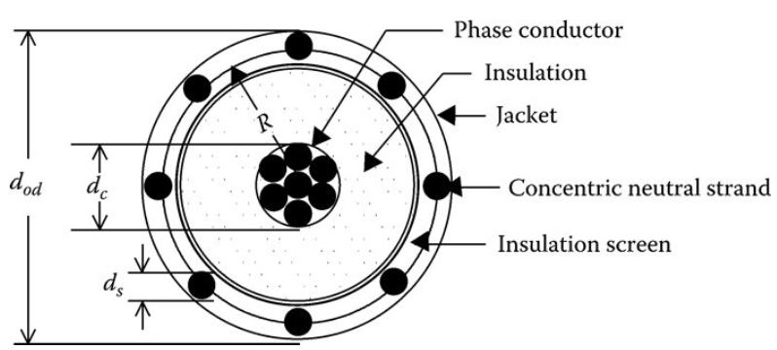
Concentric Neutral Cable
Fig.10 shows a simple detail of a concentric neutral cable. The cable consists of a central “phase conductor” covered by a thin layer of nonmetallic semiconducting screen to which is bonded the insulating material. The insulation is then covered by a semiconducting insulation screen. The solid strands of concentric neutral are spiraled around the semiconducting screen with a uniform spacing between strands. Some cables will also have an insulating “jacket” encircling the neutral strands.
Fig.10 Concentric neutral cable
ECpE Department

Slide 60
Concentric Neutral Cable
In order to apply Carson's equations to this cable, the following data needs to be extracted from a table of underground cables (Appendices A and B in Kersting Book)
d_{c} is the phase conductor diameter (in.).
d_{od} is the nominal diameter over the concentric neutrals of the cable (in.).
d_{s} is the diameter of a concentric neutral strand (in.).
GMR_{c} is the geometric mean radius of the phase conductor (ft).
GMR_{s} is the geometric mean radius of a neutral strand (ft).
r_{c} is the resistance of the phase conductor (Ω/mile).
r_{s} is the resistance of a solid neutral strand (Ω/mile).
k is the number of concentric neutral strands.
Fig.10 Concentric neutral cable
ECpE Department

Slide 61
Concentric Neutral Cable
The GMRs of the phase conductor and a neutral strand are obtained from a standard table of conductor data (Appendix A, Kersting). The equivalent GMR of the concentric neutral is computed using the equation for the GMR of bundled conductors used in high-voltage transmission lines:
$${GMR}_{cn}=\sqrt[k]{{GMR}_{s}∗k∗R^{k−1}} ft$$
(72)
where R is the radius of a circle passing through the center of the concentric neutral strands given by
$$R=\frac{d_{od}−d_{s}}{24}ft$$
(73)
Fig.10 Concentric neutral cable
ECpE Department

Slide 62
Concentric Neutral Cable
$$R=\frac{d_{od}−d_{s}}{24}ft$$
(73)
The equivalent resistance of the concentric neutral is
$$r_{cn}=\frac{r_{s}}{k} Ω\text{/}\text{mile}$$
(74)
The various spacings between a concentric neutral and the phase conductors and other concentric neutrals are as follows:
Concentric neutral to its own phase conductor
D_{ij} = R (Equation (73))
Concentric neutral to an adjacent concentric neutral
D_{ij} is the center-to-center distance of the phase conductors
Concentric neutral to an adjacent phase conductor
ECpE Department

Slide 63
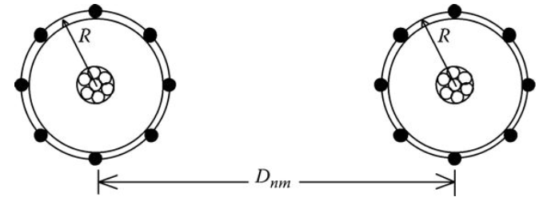
Concentric Neutral Cable
Fig.11 shows the relationship between the distance between centers of concentric neutral cables and the radius of a circle passing through the centers of the neutral strands.
The GMD between a concentric neutral and an adjacent phase conductor is given by
$$D_{ij}=\sqrt[k]{D_{nm}^{k}−R^{k}} ft$$
(75)
where D_{nm} is the center-to-center distance between phase conductors.
Fig.11 Distance between concentric neutral cables
ECpE Department

Slide 64
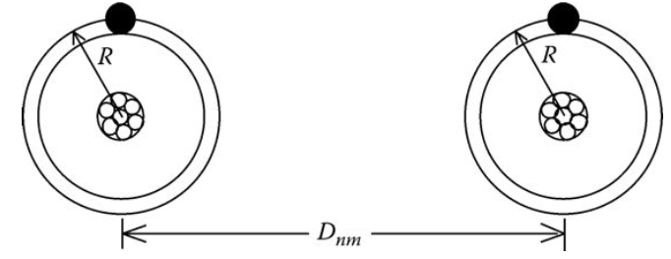
Concentric Neutral Cable
The distance between cables will be much greater than the radius R so a good approximation of modeling the concentric neutral cables is shown in Fig.12. In this figure, the concentric neutrals are modeled as one equivalent conductor (shown in black) directly above the phase conductor.
In applying the modified Carson's equations, the numbering of conductors and neutrals is important. For example, a three-phase underground circuit with an additional neutral conductor must be numbered as follows:
1 representing phase a conductor #1
2 representing phase b conductor #2
3 representing phase c conductor #3
4 representing neutral of conductor #1
5 representing neutral of conductor #2
6 representing neutral of conductor #3
7 representing additional neutral conductor (if present)
Fig.12 Distance between concentric neutral cables
ECpE Department

Slide 65
Example 3
Three concentric neutral cables are buried in a trench with spacings as shown in Fig.13. The concentric neutral cables of Fig.13 can be modeled as shown in Fig.14. Notice the numbering of the phase conductors and the equivalent neutrals.
The cables are 15 kV, 250,000 circular mil (CM) stranded AA with 13 strands of #14 annealed coated copper wires (one-third neutral). The outside diameter of the cable over the neutral strands is 1.29 in. (Appendix B, Kersting). Determine the phase impedance matrix and the sequence impedance matrix.
Fig.13 Three-phase concentric neutral cable spacing
Fig.14 Three-phase equivalent neutral cable spacing
ECpE Department

Slide 66
Example 3
Solution
The data for the phase conductor and neutral strands from a conductor data table (Appendix A) are as follows:
250,000 AA phase conductor:
GMR_{p} = 0.0171 ft
Diameter = 0.567 in.
Resistance = 0.4100 Ω/mile
#14 copper neutral strands:
GMR_{s} = 0.00208 ft
Resistance = 14.87 Ω/mile
Diameter (d_{s}) = 0.0641 in.
The radius of the circle passing through the center of the strands (Equation (73)) is
$$R=\frac{d_{od}−d_{s}}{24}=0.0511 ft$$
ECpE Department

Slide 67
Example 3
The equivalent GMR of the concentric neutral is computed by
$${GMR}_{cn}=\sqrt[k]{{GMR}_{s}∗k∗R^{k−1}}=\sqrt[13]{0.00208∗13∗{0.0511}^{13−1}}=0.0486 ft$$
The equivalent resistance of the concentric neutral is
$$r_{cn}=\frac{r_{s}}{k}=\frac{14.8722}{13}=1.144 Ω\text{/}\text{mile}$$
The phase conductors are numbered 1, 2, and 3. The concentric neutrals are numbered 4, 5, and 6.
A convenient method of computing the various spacings is to define each conductor using Cartesian coordinates. Using this approach the conductor coordinates are
$d_{1}=0+j0$, $d_{2}=0.5+j0$, $d_{3}=1+1j0$
$d_{4}=0+jR$, $d_{5}=0.5+jR$, $d_{6}=1+jR$
ECpE Department

Slide 68
Example 3
The off-diagonal terms of the spacing matrix are computed by
For n=1 to 6 and m=1 to 6
$$D_{n,m}=\left|d_{n}−d_{m}\right|$$
The diagonal terms of the spacing matrix are the GMRs of the phase conductors and the equivalent neutral conductors:
For i=1 to 3 and j=4 to 6
$$D_{i,i}={GMR}_{p}$$
$$D_{j,j}={GMR}_{s}$$
The resulting spacing matrix is
ECpE Department

Slide 69
Example 3
The self-impedance for the cable in position 1 is
$\hat{z_{11}}=0.0953+0.41+j0.12134(\ln{\frac{1}{0.0171}}+7.93402$)=0.5053+j1.4564 $Ω\text{/}\text{mile}$
The self-impedance for the concentric neutral for cable #1 is
$\hat{z_{44}}=0.0953+1.144+j0.12134(\ln{\frac{1}{0.0486}}+7.93402$)=1.2391+j1.3296 $Ω\text{/}\text{mile}$
The mutual impedance between cable #1 and cable #2 is
$\hat{z_{12}}=0.0953+j0.12134(\ln{\frac{1}{0.5}}+7.93402$)=0.0953+j1.0468 $Ω\text{/}\text{mile}$
The mutual impedance between cable #1 and its concentric neutral is
$\hat{z_{14}}=0.0953+j0.12134(\ln{\frac{1}{0.0511}}+7.93402$)=0.0953+j1.3236 $Ω\text{/}\text{mile}$
The mutual impedance between the concentric neutral of cable #1 and the concentric neutral of cable #2 is
$\hat{z_{45}}=0.0953+j0.12134(\ln{\frac{1}{0.5}}+7.93402$)=0.0953+j1.0468 $Ω\text{/}\text{mile}$
ECpE Department

Slide 70
Example 3
Continuing the application of the modified Carson's equations results in a 6 × 6 primitive impedance matrix. This matrix in partitioned form is
$\left[\hat{z_{ij}}\right]= \left[\begin{matrix}0.5053+j1.4564 & 0.0953+j1.0468 & 0.0953+j0.9627 \\ 0.0953+j1.0468 & 0.5053+j1.4564 & 0.0953+j1.0468 \\ 0.0953+j0.9627 & 0.0953+j1.0468 & 0.5053+j1.4564\end{matrix}\right]$ $Ω\text{/}\text{mile}$
$\left[\hat{z_{in}}\right]= \left[\begin{matrix}0.0953+j1.3236 & 0.0953+j1.0468 & 0.0953+j0.9627 \\ 0.0953+j1.0468 & 0.0953+j1.3236 & 0.0953+j1.0462 \\ 0.0953+j0.9626 & 0.0953+j1.0462 & 0.0953+j1.3236\end{matrix}\right]$ $Ω\text{/}\text{mile}$
$$\left[\hat{z_{nj}}\right]=\left[\hat{z_{in}}\right]$$
$\left[\hat{z_{nn}}\right]= \left[\begin{matrix}1.2393+j1.3296 & 0.0953+j1.0468 & 0.0953+j0.9627 \\ 0.0953+j1.0468 & 1.2393+j1.3296 & 0.0953+j1.0468 \\ 0.0953+j0.9627 & 0.0953+j1.0468 & 1.2393+j1.3296\end{matrix}\right]$ $Ω\text{/}\text{mile}$
Using the Kron reduction results in the phase impedance matrix:
$\left[z_{abc}\right]=\left[\hat{z_{ij}}\right]−{\left[\hat{z_{in}}\right]∗\left[\hat{z_{nn}}\right]}^{−1}∗\left[\hat{z_{nj}}\right]$
$= \left[\begin{matrix}0.7981+j0.4467 & 0.3188+j0.0334 & 0.2848−j0.0138 \\ 0.3188+j0.0334 & 0.7890+j0.4048 & 0.3188+j0.0334 \\ 0.2848−j0.0138 & 0.3188+j0.0334 & 0.7981+j0.4467\end{matrix}\right]$ $Ω\text{/}\text{mile}$
ECpE Department

Slide 71
Example 3
${\left[Z_{012}\right]=[A_{s}]}^{−1}[Z_{abc}]$ $[A_{s}]$=$\left[\begin{matrix}Z_{00} & Z_{01} & Z_{02} \\ Z_{10} & Z_{11} & Z_{12} \\ Z_{20} & Z_{21} & Z_{22}\end{matrix}\right]$
(55)
The sequence impedance matrix for the concentric neutral three-phase line is determined using Equation (55):
${\left[Z_{012}\right]=[A_{s}]}^{−1}[Z_{abc}]$ $[A_{s}]$
=$\left[\begin{matrix}1.4140+j0.4681 & −0.0026−j0.0081 & −0.0057+j0.0063 \\ −0.0057+j0.0063 & 0.4876+j0.4151 & −0.0265+j0.0450 \\ −0.0026−j0.0081 & 0.0523+j0.0004 & 0.4876+j0.4151\end{matrix}\right]$ $Ω\text{/}\text{mile}$
ECpE Department

Slide 72
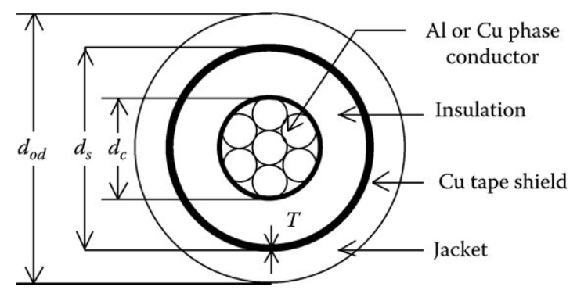
Tape-Shielded Cables
Fig.15 shows a simple detail of a tape-shielded cable. The cable consists of a central “phase conductor” covered by a thin layer of nonmetallic semiconducting screen to which is bonded the insulating material. The insulation is covered by a semiconducting insulation screen. The shield is bare copper tape helically applied around the insulation screen. An insulating “jacket” encircles the tape shield.
Fig.15 Tape-shielded cable
ECpE Department

Slide 73
Tape-Shielded Cables
Parameters of the tape-shielded cable are
d_{c} is the diameter of phase conductor (in.)
d_{s} is the outside diameter of the tape shield (in.)
d_{od} is the outside diameter over jacket (in.)
T is the thickness of copper tape shield (mil)
Once again the modified Carson's equations will be applied to calculate the self-impedances of the phase conductor and the tape shield as well as the mutual impedance between the phase conductor and the tape shield. The resistance and GMR of the phase conductor are found in a standard table of conductor data (Appendix A, Kersting).
Fig.15 Tape-shielded cable
ECpE Department

Slide 74
Tape-Shielded Cables
Once again the modified Carson's equations will be applied to calculate the self-impedances of the phase conductor and the tape shield as well as the mutual impedance between the phase conductor and the tape shield.
The resistance and GMR of the phase conductor are found in a standard table of conductor data (Appendix A, Kersting).
The resistance of the tape shield is given by
$$r_{shield}=7.9385∗{10}^{8}∗\frac{ρ}{d_{s}∗T} Ω\text{/}\text{mile}$$
(76)
Fig.15 Tape-shielded cable
ECpE Department

Slide 75
Tape-Shielded Cables
$$r_{shield}=7.9385∗{10}^{8}∗\frac{ρ}{d_{s}∗T} Ω\text{/}\text{mile}$$
(76)
The resistance of the tape shield given in Equation (76) assumes a resistivity of 100 Ω-m and a temperature of 50°C. The outside diameter of the tape shield d_{s} is given in inches and the thickness of the tape shield T in mil.
The GMR of the tape shield is the radius of a circle passing through the middle of the shield and is given by
$${GMR}_{shield}=\frac{{(d}_{s}/2)−(T/2000)}{12} ft$$
(77)
Fig.15 Tape-shielded cable
ECpE Department

Slide 76
Tape-Shielded Cables
The various spacings between a tape shield and the conductors and other tape shields are as follows:
Tape shield to its own phase conductor
$${D_{ij}=GMR}_{shield}=Radius to midpoint of the shield (ft)$$
(79)
Tape shield to an adjacent tape shield
$$D_{ij}=Center to center distance of the phase conductors (ft)$$
(80)
Tape shield to an adjacent phase or neutral conductor
(81)
$$D_{ij}=D_{nm}(ft)$$
where D_{nm} is the center-to-center distance between phase conductors.
ECpE Department

Slide 77
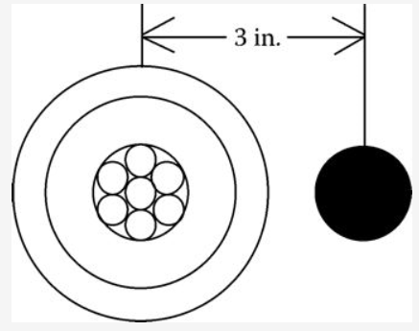
Example 4
A single-phase circuit consists of a 1/0 AA, 220 mil insulation tape-shielded cable and a 1/0 CU neutral conductor as shown in Fig.16. The single-phase line is connected to phase b. Determine the phase impedance matrix.
Cable data: 1/0 AA
Outside diameter of the tape shield = d_{s} = 0.88 in.
Resistance = 0.97 Ω/mile
GMR_{p} = 0.0111 ft
Tape shield thickness = T = 5 mil
Neutral data: 1/0 copper, 7 strand
Resistance = 0.607 Ω/mile
GMR_{n} = 0.01113 ft
Distance between cable and neutral = D_{nm} = 3 in.
Fig.16 Single-phase tape shield with neutral
ECpE Department

Slide 78
Example 4
The resistance of the tape shield is computed according to Equation (76):
$$r_{shield}=\frac{18.826}{d_{s}∗T}=\frac{18.826}{0.88∗5}=4.2786 Ω\text{/}\text{mile}$$
The GMR of the tape shield is computed according to Equation (77):
$${GMR}_{shield}=\frac{{(d}_{s}/2)−(T/2000)}{12}=\frac{(0.88/2)−(5/2000)}{12}=0.0365 ft$$
The conductors are numbered such that
#1 represents 1/0 AA conductor
#2 represents tape shield
#3 represents 1/0 copper ground
The spacings used in the modified Carson's equations are
$$D_{12}={GMR}_{shield}=0.0365$$
$$D_{13}=\frac{3}{12}=0.25$$
ECpE Department

Slide 79
Example 4
The self-impedance of conductor #1 is
$\hat{z_{11}}=0.0953+0.97+j0.12134(\ln{\frac{1}{0.0111}}+7.93402$)=1.0653+j1.5088 $Ω\text{/}\text{mile}$
The mutual impedance between conductor #1 and the tape shield (conductor #2) is
$\hat{z_{12}}=0.0953+j0.12134(\ln{\frac{1}{0.0365}}+7.93402$)=0.0953+j1.3645 $Ω\text{/}\text{mile}$
The self-impedance of the tape shield (conductor #2) is
$\hat{z_{22}}=0.0953+4.2786+j0.12134(\ln{\frac{1}{0.0365}}+7.93402$)=4.3739+j1.3645 $Ω\text{/}\text{mile}$
The final primitive impedance matrix is
$\left[\hat{z}\right]= \left[\begin{matrix}1.0653+j1.5088 & 0.0953+j1.3645 & 0.0953+j1.1309 \\ 0.0953+j1.3645 & 4.3739+j1.3645 & 0.0953+j1.1309 \\ 0.0953+j1.1309 & 0.0953+j1.1309 & 0.7023+j1.5085\end{matrix}\right]$ $Ω\text{/}\text{mile}$
ECpE Department

Slide 80
Example 4
In partitioned form, the primitive impedance matrix is
$\left[\hat{z_{ij}}\right]=1.0653+j1.5088$ $Ω\text{/}\text{mile}$
$\left[\hat{z_{in}}\right]=\left[0.0953+j1.3645 0.0953+j1.1309\right]$ $Ω\text{/}\text{mile}$
$\left[\hat{z_{nj}}\right]=\left[\begin{aligned}0.0953+j1.3645 \\ 0.0953+j1.1309\end{aligned}\right]$ $Ω\text{/}\text{mile}$
$$\left[\hat{z_{nj}}\right]=\left[\begin{matrix}4.3739+j1.3645 & 0.0953+j1.1309 \\ 0.0953+j1.1309 & 0.7023+j1.5085\end{matrix}\right]Ω\text{/}\text{mile}$$
Applying Kron reduction method will result in a single impedance, which represents the equivalent single-phase impedance of the tape shield cable and the neutral conductor:
$${\left[z_{1p}\right]=\left[\hat{z_{1p}}\right]−\left[\hat{z_{1n}}\right][\hat{z_{nn}}]}^{−1}[\hat{z_{nj}}]$$
$z_{1p}=1.3219+j0.6743$ $Ω\text{/}\text{mile}$
Since the single-phase line is on phase b, then the phase impedance matrix for the line is
$\left[z_{abc}\right]= \left[\begin{matrix}0 & 0 & 0 \\ 0 & 1.3219+j0.6743 & 0 \\ 0 & 0 & 0\end{matrix}\right]$ $Ω\text{/}\text{mile}$
ECpE Department

Slide 81
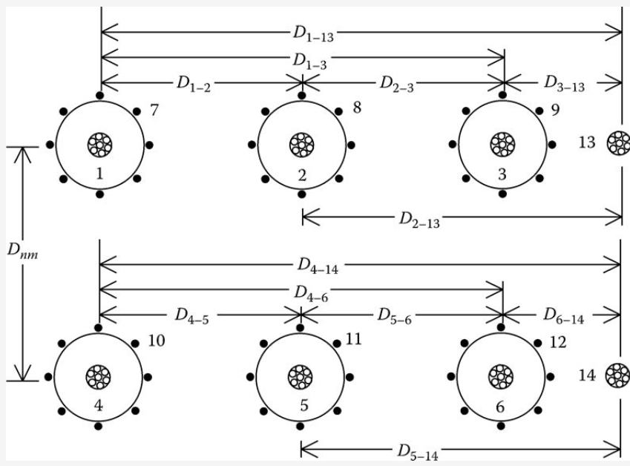
Parallel Underground Distribution Lines
Fig.17 shows two concentric neutral parallel lines each with a separate grounded neutral conductor.
The process for computing the 6 × 6 phase impedance matrix follows exactly the same procedure as for the overhead lines. In this case, there are a total of 14 conductors (6 phase conductors, 6 equivalent concentric neutral conductors, and 2 grounded neutral conductors). Applying Carson's equations will result in a 14 × 14 primitive impedance matrix. This matrix is partitioned between the sixth and seventh rows and columns. The Kron reduction is applied to form the final 6 × 6 phase impedance matrix.
Fig.17 Parallel concentric neutral underground lines
ECpE Department

Slide 82
Thank You!
ECpE Department

